Slide 1
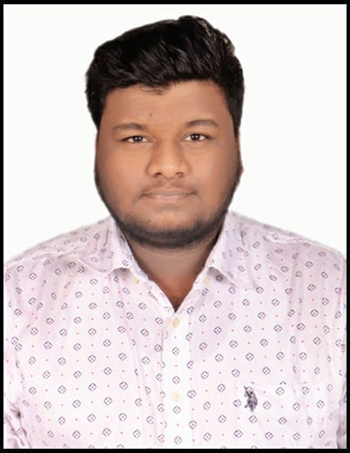


Charanraj Goud Gajagouni
Analyst/Software Engineer
Bachelor of Technlogy, Computer Science Engineering : 2016 - 2020
Skills
JAVA & Python | Concepts of Core JAVA, Python Basics, OOPS, Generics, Collections, Arrays.
C# | C#Basics, OOPS, Generics, Collections, Arrays.
.NET | ADO.NET,ASP.NET with MVC5 and WEB API, Entity Framework
Version Control Tool | Git, GitHub, Branches, Merging
Angular | Components, Services, Modules, Routing, Forms & Validation.
UI | HTML 5 & CSS 3,JavaScript, ES6 & TypeScript ,Bootstrap
Data Base | Microsoft Sql Server
Tools | Git, SSMS, Visual Studio, Visual Studio Code
Add On Skills | Peer Learning, Communication Skills.
Bangalore
Charanraj-goud.gajagouni@capgemini.com
+91-9666514160
A4
Full Stack Developer
Hands on experience on C#,ADO.NET, LINQ, Entity framework, SQL Server, ASP.NET MVC5 with WEB API, HTML, CSS, JavaScript.
Knowledge on creating Single page Web Application in Angular and React.
Knowledge on creating databases in SSMS.
Having Knowledge on Git And GitHub.
Certified with Microsoft Azure Fundamentals (AZ-900) and Microsoft Azure Administrator (AZ-104).
Online Hotel Management System
Case study of Online Hotel Management System developed using SQL Server for Database, .NET Core Web API for backend along with API Gateway, Swagger along with Entity Framework Core, and Front-End responsive UI with HTML5, CSS, TypeScript, Bootstrap, Nodejs and Angular Framework.
Degreed :
Successfully completed the degreed training in Git, SQL, C#, ADO.NET, Entity Framework, .NET Core, HTML, CSS, Java script, ES6, Typescript, Angular and React.
Check out my work on GitHub

